Slide 1

Post Quantum Cryptography
By Brandon LaPointe

Slide 2
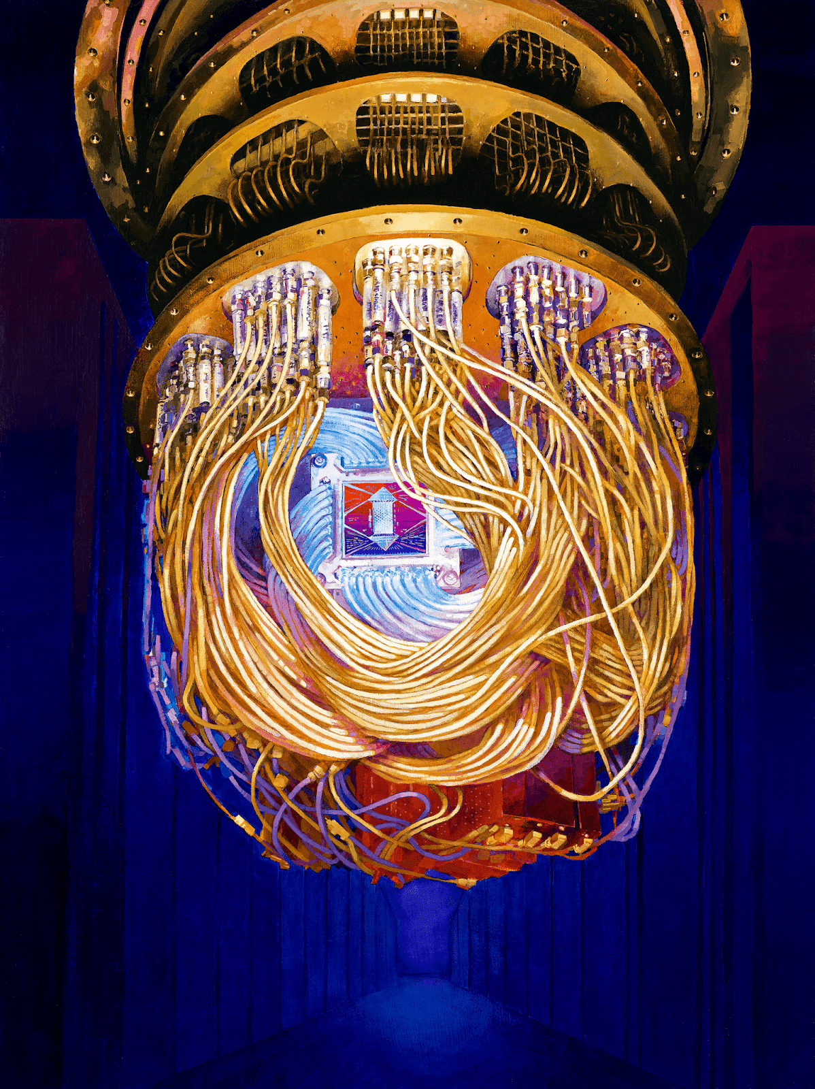
Brief Intro TO Quantum Computing
As normal computers utilize bits for computations, quantum computers rely on quantum bits, or qubits, which can be in multiple states at the same time.
Quantum bits can represent 0, 1, or a quantum superposition of 0 and 1, meaning that computations that would usually need to be performed on a 0 or 1 separately on a classical computer could be completed in a single operation using a qubit.
This means that quantum computers can handle 2^{n} computations in a single step, with n being the number of qubits the quantum computer contains.
Ex: A 50 qubit quantum computer can compute 1,125,899,906,842,624 (1.125 quadrillion) states in a single operation.
This results in massive performance gains in certain cases like integer factorization and simulations.

Slide 3
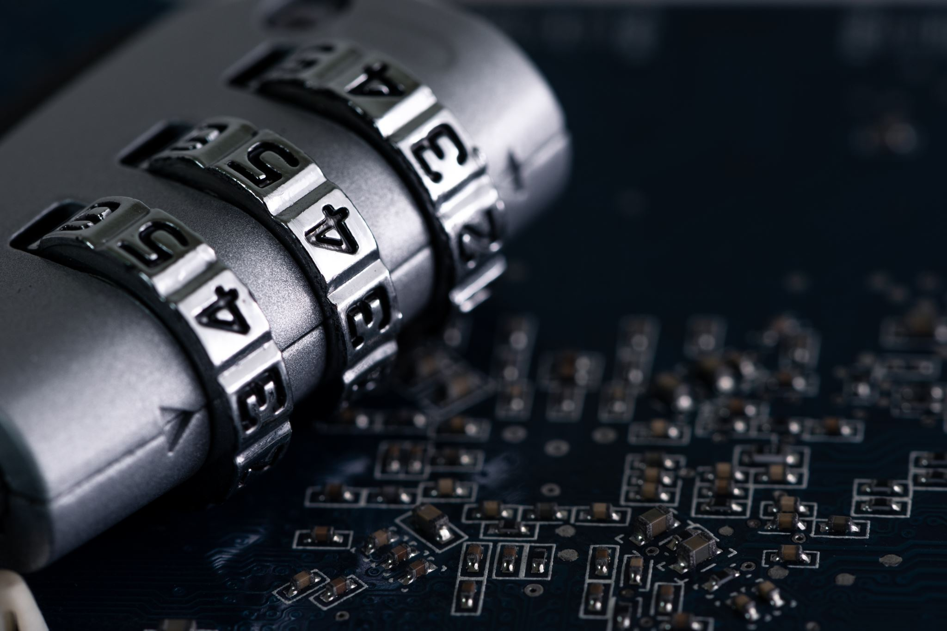
What is Post-quantum cryptography?
Post Quantum Cryptography refers to the potential use of future quantum computing technologies to crack modern cryptographic standards of security and the development of cryptographic systems to be secure against these attacks.
While quantum computing technology is still in the process of initial development, the risk to systems involving data confidentiality and integrity of security is crucial to make resilient to this future threat.
With the National Institute of Standards and Technology (NIST) planning on publishing its new post-quantum cryptographic standard in 2024, this upcoming future of cyber security is closer than it seems.

Slide 4
Current Cryptographic Standards: The “Big Three”
The "Big Three" cryptosystems are the most widely used public-key encryption methods today and includes RSA, Diffie-Hellman, and Elliptic Curve Cryptography (ECC).
RSA, which stands for Rivest, Shamir, and Adleman, is based on the difficulty of factoring large integers into their prime factors.
Widely used for secure data transmission and digital signatures.
Diffie-Hellman is based on the discrete logarithm problem.
Used for secure key exchange in a public channel.
Elliptic Curve Cryptography (ECC) relies on the difficulty of solving the elliptic curve discrete logarithm problem for its security.
Often used in applications where computational power and storage are limited, such as mobile devices and smart cards as ECC generally uses smaller key sizes leading to faster computation times.
Despite their widespread use and effectiveness, these cryptosystems are all vulnerable to attacks by quantum computers.

Slide 5
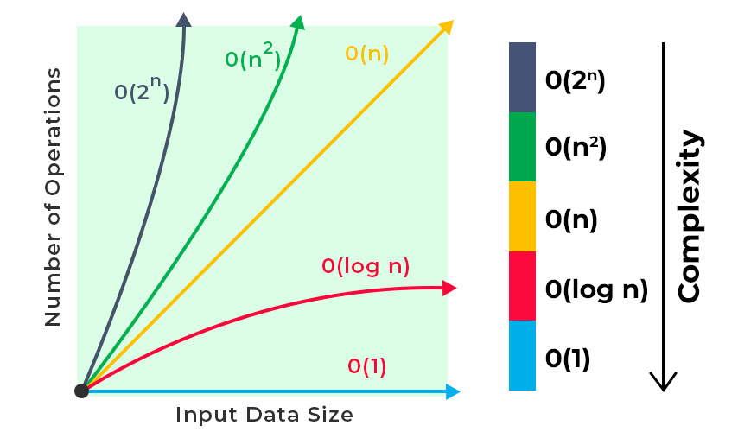
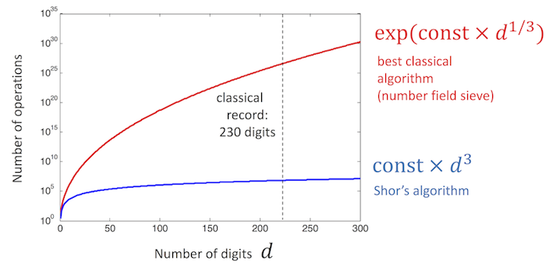
The impact of quantum computers on modern computing is significant, particularly in the field of cryptography.
For classical computers, the best-known factoring algorithm is the General Number Field Sieve (GNFS). However, Shor's algorithm is a quantum computer algorithm that can factor numbers exponentially faster than classical algorithms like the General Number Field Sieve.
Shor's algorithm has a time complexity of O((log N)³), where N is the number being factored.
This simply means that as the size of the number being factored increases, the time it takes to factor the number grows much slower than with classical algorithms.
This increased efficiency of factoring algorithms ultimately leads to decreased security of cryptosystems which rely on the difficulty of the algorithms they use, as attackers may be able to break the encryptions and access confidential information.
Source: https://quantum-computing.ibm.com/composer/docs/iqx/guide/shors-algorithm

Slide 6
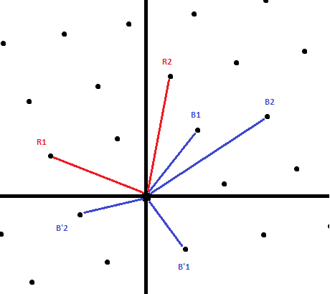
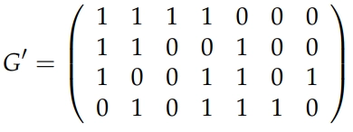
Potential Candidates for securing a post quantum computing world
One of the most promising approaches to post-quantum cryptography is lattice-based cryptography.
This is a relatively new field that is based on the use of lattices, which are geometrical structures that can be used to encode information in a way that is difficult for quantum computers to crack.
The most popular lattice-based cryptographic algorithm is the Learning With Errors (LWE) problem.
Another promising post-quantum cryptographic approach is multivariate polynomial cryptography.
This uses the difficulty of solving non-linear equations to create hard problems for quantum computers.
One well known example of a multivariate polynomial cryptosystem is the Unbalanced Oil and Vinegar (UOV) cryptosystem.
A third post-quantum cryptographic approach to be considered is code-based cryptography.
This approach uses error-correcting codes to create a hard problem for quantum computers.
The most prevalent examples of code-based cryptography include the Niederreiter Cryptosystem and the McEliece Cryptosystem.

Slide 7

Code-Based PQC: The McEliece cryptosystem
The McEliece cryptosystem is a public-key encryption algorithm that was proposed in 1978 by Robert McEliece. It is based on the principle of error-correcting codes known as Goppa codes and is considered one of the most secure cryptosystems available today.
The McEliece encryption process involves encoding a message with a public key and injecting it with errors before sending, while the decryption process involves correcting the errors and decoding the encoded message with a private key that is generated by the user.
The private key is a binary Goppa code, and the public key is a matrix generated from the Goppa code.
The encryption process involves multiplying the message by the public key matrix and adding a random error vector.
The resulting ciphertext can then be decrypted using the private key, which involves finding the syndrome of the received vector and decoding it using the Goppa code.
The syndrome is basically a set of values that provide information about the errors that were introduced during the encryption process.
The security of the McEliece cryptosystem relies on the difficulty of decoding the Goppa code, which is believed to be a hard problem even for quantum computers.

Slide 8
McEliece in more detail
In the original McEliece cryptosystem published in 1978, McEliece suggested using a Goppa code of length 1024 with a dimension of 524, and correction capability of up to 50 errors.
(n = 1024, k = 524, t = 50).
Goppa code-based McEliece Cryptology with parameters n = 4096, k = 3844, t = 21 results in 121,086 bytes at the security level of 128 bits and is unbreakable by modern cryptographic standards.
The main issue of the McEliece cryptosystem comes from the size of the Goppa code, leading to the cryptosystem being relatively slow in comparison to modern public-key cryptosystems when paired with current technologies. With future advancements in memory capabilities within computers and quantum computers, the McEliece cryptosystem will become more practical in use.

Slide 9
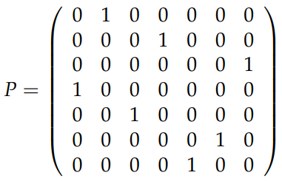
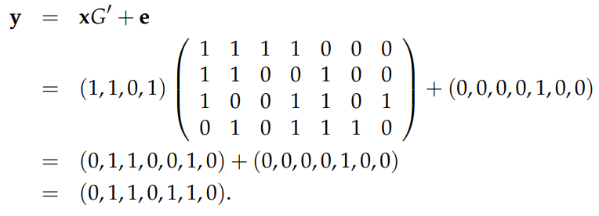
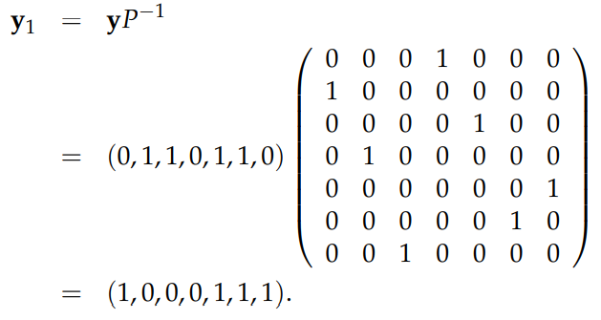
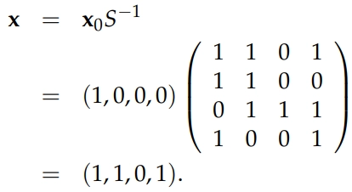
Alice and Bob example
Key:
e = Random Error Vector
e’ = Error-Syndrome
G = Generator Matrix
G’ = Modified Generator Matrix
P = Random Permutation Matrix S = Random Invertible Matrix
t = Max Number of Errors
x = Binary String Representation of Plaintext
x₀ = Codeword from error-correction process
y = Code vector from encryption process
y₁ = Code vector from decryption process
McEliece is a private key cryptosystem meaning that within an example where Alice wants to send Bob a message, Alice would encrypt her message using Bob’s public key. Bob then uses his private key to decrypt the message.
1.) Bob creates his public and private keys.
Using the McEliece cryptosystem, Bob would create a public key by specifying a Goppa polynomial, g(z) of degree t, before computing the generator matrix, G = k*n, of the Goppa code. Bob then chooses a random invertible matrix, S, and a random permutation matrix, P, using them to compute a modified generator matrix, G’ = ((S)(G)(P)). Bob then publishes his public key consisting of (G’, t) while his private key consists of (S, G, P).
2.) Alice encrypts her message with Bob’s public key.
Alice takes her message, represented as binary string of bits, and encrypts the string into a codeword using Bob’s public key.
3.) Alice adds errors to her encryption and sends the final encryption to Bob.
Alice then chooses a random error vector with weight of t or less before adding it to the encryption and sending the final encryption with the code vector y = (x)(G’)+e.
4.) The errors that were introduced during the encryption process are corrected, leaving the original codeword. This codeword is then used to calculate the plaintext by applying the inverse operation of the encoding process.
Bob then uses his matrix, P, to calculate the code vector, y₁= (y)(P⁻¹), before using the decoding algorithm for his Goppa code, G, to error correct y₁ into the codeword, x₀, by finding the error-syndrome, e’. Since Bob already knows the value of S⁻¹, he can calculate Alice’s message x = x₀S⁻¹.
Examples of matrixes and calculations from codingninjas.com:
G’
x
e
P⁻¹
S⁻¹
y
x₀

Slide 10
Implementing McEliece using bouncy castle in java
Bouncy Castle is an open-source cryptography library for Java, .NET, and C# developers.
This library supports a wide variety of cryptographic algorithms and secure protocols such as symmetric and asymmetric key cryptography, hash functions, digital signature algorithms, and X.509 certificates.
Using the Bouncy Castle library, I was able to implement the McEliece cryptosystem into Java as simply as I could to demonstrate an encryption and decryption process of a hard coded string variable in two ways:
Using default parameters of m, the number of parity-check bits, and t, the max number of errors that can be corrected, to generate the public and private keys.
Using hard-coded parameters of m and t to test the effects of variations of the two parameters.

Slide 11
Java code test Results & Conclusions
As m increases with a fixed t value:
The runtime, generator matrix size, codeword length, and field polynomial size all were positively correlated to the value of m.
The codeword length doubled in size with each incrementation of m.
As t increases with a fixed m value:
The runtime and value of t were positively correlated while codeword length and field polynomial size remained the same.
As t was incremented by 5, the generator matrix size slightly decreased.
The parameters m and t help determine the security and efficiency of the McEliece cryptosystem.
A larger value of m leads to stronger security against attacks such as information set decoding but also requires significantly more computational resources as m increases.
A larger value of t provides better error-correcting capability with a slight increase in computational resources as t increases which results in an increased security of the system in the following ways:
If an attacker can successfully introduce errors that exceed the error correction capability of the system, then the decryption process will fail, and the original message will not be recovered.
If an attacker has access to multiple encrypted messages, they may be able to analyze the patterns of errors and deduce information about the private key, which would compromise the security of the system.

Slide 12
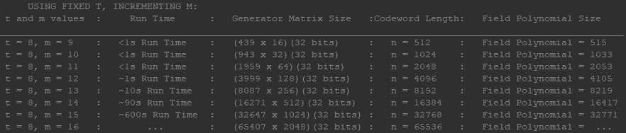
test Conclusions Cont...
To make the McEliece cryptosystem post-quantum secure, the code length and error correction capability would need to be significantly increased:
Some proposed modifications use codeword lengths of around 10,000 bits or greater with error correction capabilities of several hundred bits.
From the results, we can see at a codeword length of n = 16384, with the error correction capability, t, set to a very low setting of 8, the run time for the simple encryption and decryption of the string, “Hello, post-quantum-computing world!”, took around 90 seconds.
Furthermore, we can see the dramatic increase in time complexity which derives from the limitations of modern-day computing technologies when using the code-based McEliece cryptosystem set to slightly varying levels of security standards.
While this type of system can be extremely secure, the time complexity of the algorithms involved makes it impractical to use until further developments within quantum computing can utilize these cryptosystems to their full potential at speeds more relatable to the current cryptosystems used.
It is also worth noting that the McEliece cryptosystem is not the only post-quantum secure cryptosystem under development as there are several other PQCs that are being developed and evaluated, each with its own set of advantages and disadvantages.

Slide 13
The Challenges halting quantum computing
Despite the ongoing development of quantum computing technology, there are still notable challenges that need to be overcome before we can build larger-scale, fault-tolerant quantum computers that can solve practical problems. These problems include:
ERROR CORRECTION:
Quantum computers are extremely sensitive to noise and errors, requiring reliable error correction techniques for practical use.
SCALABILITY:
Scaling up quantum computers to hundreds or thousands of qubits while maintaining high levels of coherence and low error rates is a major challenge.
STANDARDS AND PROTOCOLS:
Developing standards and protocols for hardware, software, and communication interfaces is necessary for compatibility between other quantum and classical computers.
OVERALL EXPENSE:
Quantum computing comes with immense costs, upwards of $10,000,000-$15,000,000 in some examples, and with it comes the costs of maintaining the systems. Needless to say, it will be quite some time before quantum computing is available to the public at a considerable price point.

Slide 14

In Conclusion,
Post-quantum cryptography is a rapidly evolving field that is essential for maintaining the security of communication channels in the face of quantum computing technology.
The ”Big Three” encryption methods, RSA, Diffie-Hellman, and ECC, which are widely used today, will become vulnerable to quantum attacks once quantum computers become more accessible.
Code-based cryptography, lattice-based cryptography, and multivariate polynomial cryptography are all promising approaches to post-quantum cryptography that are being actively researched.
The development of post-quantum cryptographic systems will be crucial to ensuring the security and privacy of our digital communications in the coming decades as progress continues in the field of quantum computing.

Slide 15
References Used:
“Data Center Solutions, IOT, and PC Innovation.” Intel, https://www.intel.com/content/www/us/en/newsroom/news/intel-hits-key- milestone-quantum-chip-research.html.
Flint, Rusty. “Do We Need to Worry about China Breaking RSA Encryption Technologies with Quantum Computers? - Quantum Computing News and Features.” Quantum Zeitgeist, 8 Jan. 2023, https://quantumzeitgeist.com/do-we-need-to-worry-about-china-breaking-rsa-encryption-technologies-with-quantum-computers/.
Migrating to Post-Quantum Cryptography - Whitehouse.gov. https://www.whitehouse.gov/wp-content/uploads/2022/11/M-23-02-M-Memo-on-Migrating-to-Post-Quantum-Cryptography.pdf.
“Post-Quantum Cryptography: Anticipating Threats and Preparing the Future.” ENISA, 19 Oct. 2022, https://www.enisa.europa.eu/news/enisa-news/post-quantum-cryptography-anticipating-threats-and-preparing-the-future.
The Quantum Computer and Its Implications for Public-Key Cryptosystems. https://www.entrust.com/-/media/documentation/whitepapers/sl20-1026-001-ssl_quantumcomputers-wp.pdf?la=en&hash=11184A80B0523E918F674EFF0C68137A.
Quantum Computing and Post-Quantum Cryptography. https://media.defense.gov/2021/Aug/04/2002821837/-1/-1/1/Quantum_FAQs_20210804.PDF.
Saluja, Rupal. “Code-Based Cryptography and the McEliece Cryptosystem.” Code Studio, https://www.codingninjas.com/codestudio/library/code-based-cryptography-and-the-mceliece-cryptosystem.
“What Are the Differences Between RSA, DSA, and ECC Encryption Algorithms?” Sectigo.com, https://sectigo.com/resource-library/rsa-vs-dsa-vs-ecc-encryption.
“When-and How-to Prepare for Post-Quantum Cryptography.” McKinsey & Company, McKinsey & Company, 4 May 2022, https://www.mckinsey.com/capabilities/mckinsey-digital/our-insights/when-and-how-to-prepare-for-post-quantum-cryptography.

